Slide 1
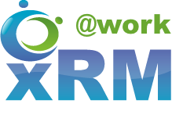
Creating Your Security Model
DYNAMICS 365

Slide 2

Mitch Milam
mitch@xrmcoaches.com
@mitchmilam
http://tinyurl.com/MitchMilamLinkedIn
https://www.youtube.com/xRMCoaches

Slide 3
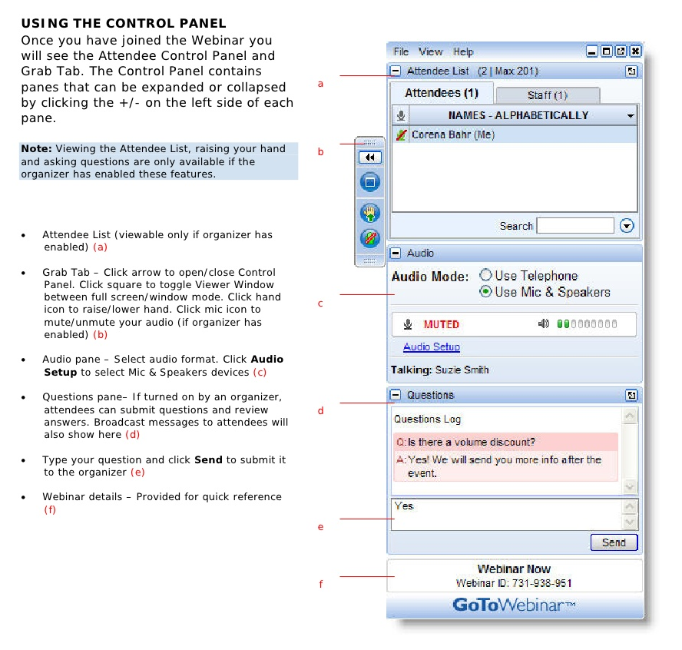
Webinar Housekeeping

Slide 4
Agenda
What we will cover today:
Business units
Users
Teams
Security Roles
Encryption
What we will not cover:
Hierarchy security

Slide 5
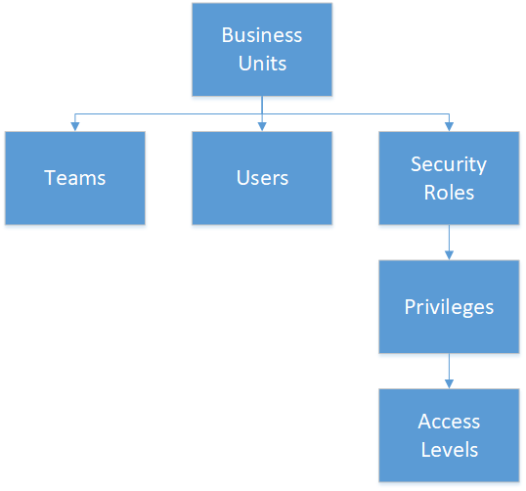
Dynamics CRM Security Overview

Slide 6
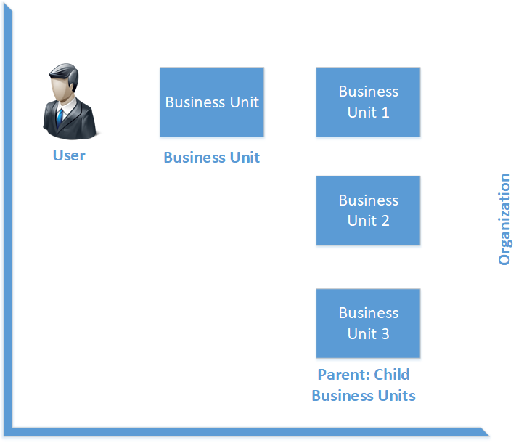
Access Levels

Slide 7
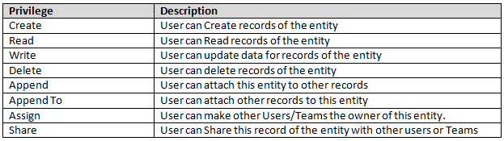
Privileges

Slide 8
Record Ownership
Organization
User
Team

Slide 9
Sharing
Bypasses pre-defined security model
Should be used with caution in high-production environments
Access Teams are the preferred method

Slide 10
Access Teams
Can't be granted security roles
Can't own records
Accesses records through sharing
Sharing privileges are defined by an access team template but don't change dynamically for existing records if the template changes
Won't be displayed in most team views
Can be system managed, directly from the form of the record that it relates to
Won't be cached because it doesn't derive privilege or ownership checks
Can't be scheduled as a resource in Service Scheduling
Not shown in team views as typically used at high volumes

Slide 11
Hierarchical Security
Two Models:
Manager
Position

Slide 12
Rule #1
DO NOT overcomplicate this process!
If you can’t explain it to someone, you did it wrong

Slide 13
Question #1: Business Unit Structure
DO NOT follow your organization chart!
Only create a new business unit to solve a specific security requirement
When all other methods are exhausted

Slide 14
Question #2: Record Ownership
User or Team
How often does record ownership change?

Slide 15
Question #3: Access Levels
Who has access to what?
What special groups with special exist?
What special accommodations must be made?

Slide 16
Question #4: Security Roles
What security roles are needed?
If you have multiple business units:
Are any business unit-specific roles needed?
Can they be inherited?
Will you assign roles at the user or team level?

Slide 17
Question #5: Field Level Security
Do you have entity-specific fields that need to be secured?

Slide 18
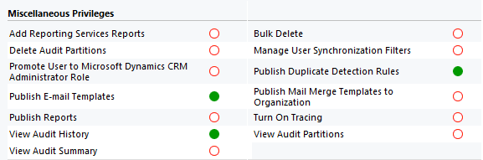
Question #6: Features

Slide 19
Implementation
1
2
3
Test
Test
Test

Slide 20
Caveats
Some security components do not move through the development cycle
Access Teams
Hierarchy security
Must be recreated in production once verified in development
XrmToolbox (Access Team Integration tool) helps move Access Teams

Slide 21
Notes
When all else fails, write a plugin
Dynamics 365 Workflow Tools
https://msdyncrmworkflowtools.codeplex.com
Always examine new technologies
Don’t be afraid to change your configuration

Slide 22
On-Premises Notes
Excessive Principle Object Access table (POA) size
Can be populated with orphan records, depending on the age of your system
Article: https://support.microsoft.com/help/2664150

Slide 23
Discussions

Slide 24
Scenario: Entity Ownership
Requirement:
Your company does not want major record types, Account, Contact, etc., owned by users but rather teams should own all records.

Slide 25
Scenario: Data Obfuscation
Requirement:
Your company periodically makes a copy of the production database and moves it back to the development and test organizations. All contact data must be redacted to prevent inadvertent access.

Slide 26
Scenario: Auto–Share an Account
Requirement:
Your company needs to automatically share an account among a group of sales representatives.

Slide 27
Scenario: Store Credit Card Numbers
Requirement:
Your company offers a subscription service where customers are charged on a monthly basis. You need to store their credit card details so that they may be billed every month.

Slide 28
Questions?

Slide 29
Thank You

